Slide 1


Avastame tehisintellekti maailma ning õpime, kuidas kasutada Gemini-t vastutustundlikult nii koolis kui ka mujal.
Tehisintellekti vastutustundliku kasutamise õpetamine
Tunnid ja tegevused õpilastele.
Notes:
Introduce the lesson and its purpose.

Slide 2

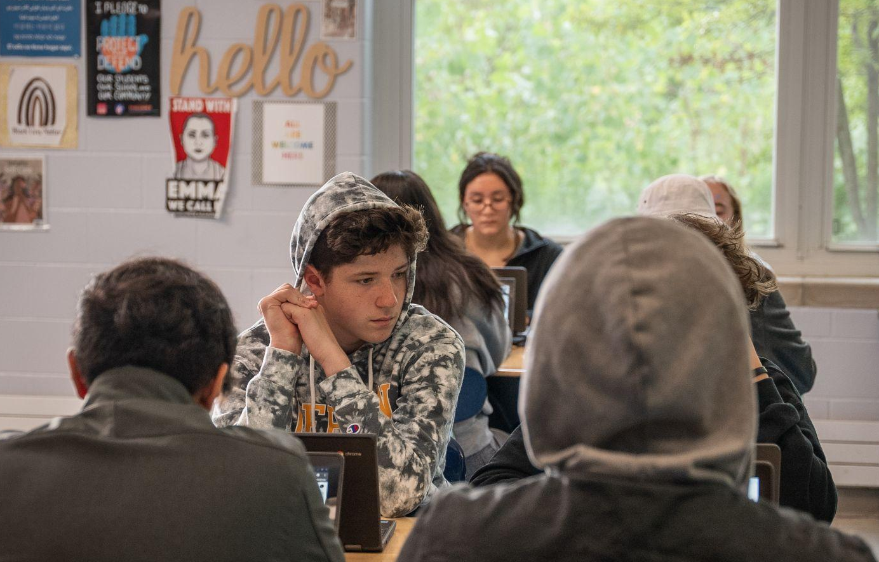
Sissejuhatus
Tehisintellekt ja sina
Tehisintellekt võib olla lõbus ja kasulik abiline.
Saad seda kasutada ajurünnakuteks, uute teadmiste omandamiseks või oma küsimustele vastuste leidmiseks.
Samuti aitab see sul luua uut sisu, pilte, heliklippe või isegi videoid ja taskuhäälinguid.
Notes:
Aim: To gain a better understanding of your students’ prior knowledge and experiences with generative AI, helping you to determine how much time you may need to dedicate to specific AI topics.
Teacher note: Begin this section by introducing AI and helpful use cases of AI for students.
Explain
Using artificial intelligence, also called AI, can be a fun and helpful tool
You can use it to help you brainstorm ideas, learn about something, or find answers to questions you might have
You can use it to create new content, images, audio or even videos and podcasts
For example, you could ask questions about different types of career fields and colleges you might be interested in

Slide 3
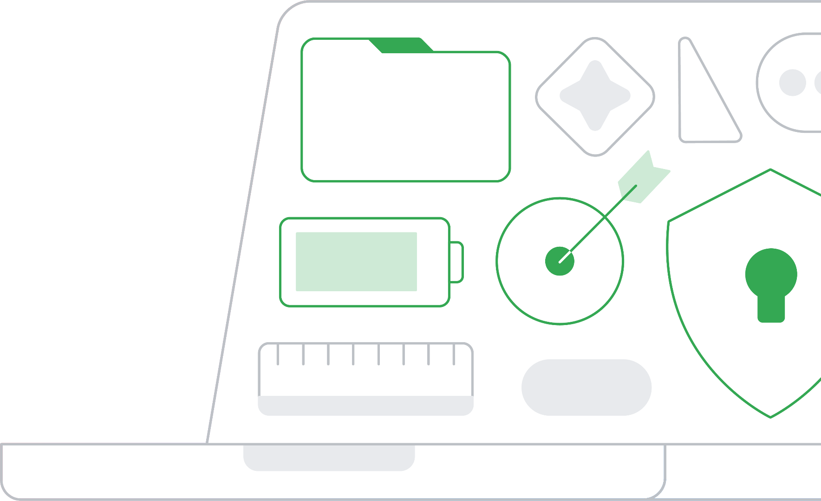
Sissejuhatus
Arutleme üheskoos
Kas keegi teist on varem kasutanud generatiivset tehisintellekti, nagu näiteks Gemini?
?
?
Kui jah, siis milleks te seda kasutanud olete?
Kas olete sellega loonud videoid, pilte või muud tüüpi sisu? Kuidas see teile kasulik oli?
?
Notes:
Click to reveal each bullet point/question on the slide.
Ask
Have any of you used a generative artificial intelligence platform like Gemini before?
If yes, what have you used them for?
Have you used it to create videos, images or other types of content?
And how was it helpful?
Teacher note:
Recommend discussing in small groups or in pairs, but the discussion can be the entire class
It may be helpful to name some other examples in addition to Gemini
Understanding if your students are using generative AI to create new content would be a good starting point to help them understand how familiar they are with the tools
It could be a good idea to poll students: Ask them to raise their hands, for example, if they have used Gemini before

Slide 4
Sissejuhatus
5 nippi tehisintellekti kasutamiseks
Tehisintellekti kasutamine võib olla väga põnev ning see pakub õpilastele palju kasulikke võimalusi.
Enne kui asume seda kasutama, peame aga mõistma, mis tehisintellekt täpselt on ja kuidas see toimib.
Pea meeles: tehisintellekt on tehnoloogia, mitte inimene.
Hinda vastuseid kriitiliselt.
Kui miski tundub kahtlane, uuri asja lähemalt.
Hoia privaatne teave privaatsena.
Kasuta tehisintellekti oma annete võimendamiseks, mitte nende asendamiseks.
Using AI can be exciting and there are a lot of ways that it is helpful for students.
Before we use it, we need to know what artificial intelligence is and how it works.
Notes:
Key takeaways
Using AI can be exciting and there are a lot of ways that it is helpful for students
Before we use it, we need to know what artificial intelligence is and how it works
And in order to get the full benefits of AI, we need to use it responsibly
To help us use AI responsibly, we have 5 AI tips that are helpful to keep in mind when using Gemini or any AI tool
🔑 The 5 tips are:
AI is technology, not human
Critically evaluate responses
If something feels off, investigate further
Keep private information private
Use AI to boost your talents, not replace them
With these tips in mind, let’s explore AI together!

Slide 5
Tehisintellekt ja generatiivne tehisintellekt
Nipp: Pea meeles, et tehisintellekt on tehnoloogia, mitte inimene.
Notes:
Aim: Provide students with an introduction to AI and generative AI, so they can start to think critically about different scenarios involving AI use.
Teacher note:
Each scenario is discussion-based to facilitate student engagement
For each discussion, you can decide if it should engage students in small groups, in pairs, or as a class
This part of the lesson equips students with the knowledge they need to complete the in-class activity

Slide 6
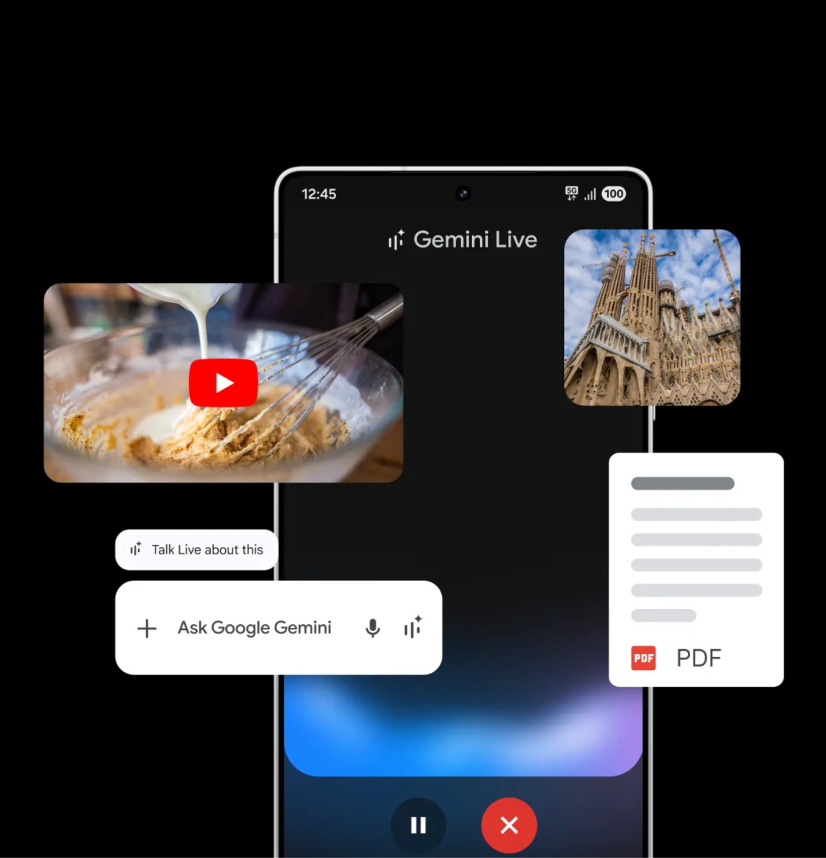
TI teemade uurimine
Mis on tehisintellekt?
Tehisintellekt (lühendatult TI/AI) on arvutisüsteem, mis tuvastab andmetes mustreid, et teha prognoose, tegutseda või luua sisu.
Näiteks kasutavad mõned meteoroloogid tehisintellekti abi ilmaennustuste koostamiseks. Analüüsides varasemaid ilmamustreid ja viies läbi simulatsioone, suudab tehisintellekt ennustada tulevasi ilmastikuolusid.
Notes:
Explain
AI is a type of technology that identifies patterns in data to make predictions, take actions, or create content
For example, some meteorologists use AI to help them make weather predictions
By analyzing past weather patterns and running simulations, AI can predict future weather conditions
Meteorologists can use these predictions to update a weather website or app with today’s forecast
You might have checked a weather app this morning to help you decide if you needed to grab sunglasses or an umbrella on your way to school
Teacher note: Share a brief overview of what AI is and an example of how students might use it when they check a weather app.

Slide 7
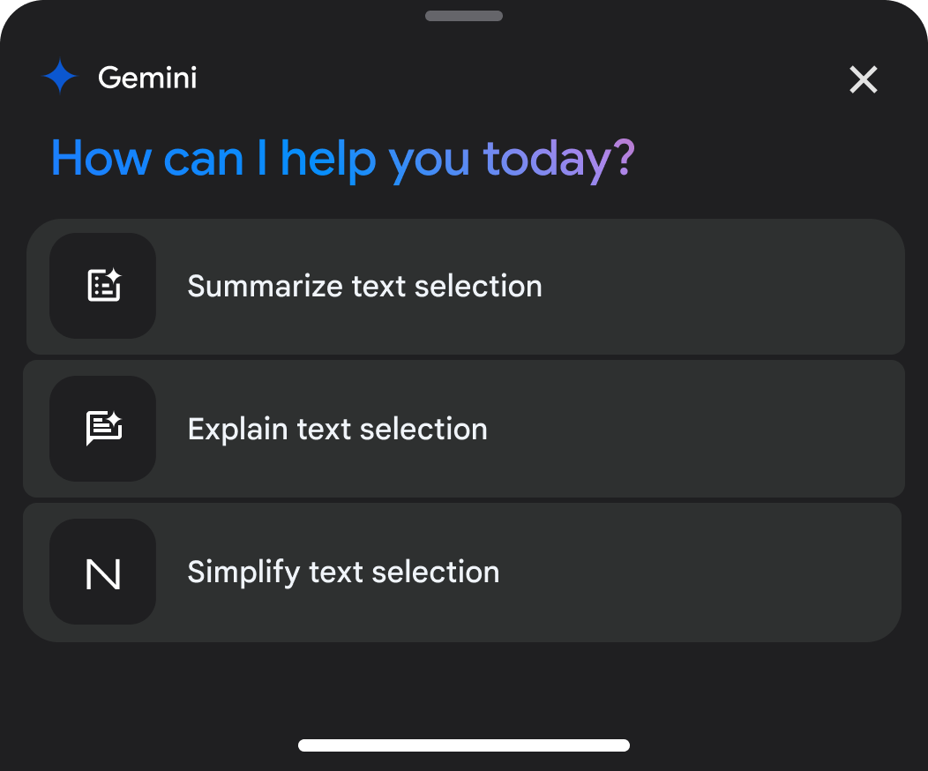
TI teemade uurimine
Mis on generatiivne tehisintellekt?
Gemini on generatiivse tehisintellekti platvorm.
See tähendab, et see suudab luua uut sisu, näiteks teksti ja pilte, ning leida linke muusikale, helifailidele ja videotele.
Notes:
Explain
Gemini is a generative AI platform. This means it can generate new content, like text, as well as music, audio files, and videos
It has the ability to generate new content because developers train the AI model on a lot of data, or information
This data provides examples that the model can identify patterns in
Once the AI model has been trained, developers incorporate that model into an AI tool, like Gemini, for you to use
To use an AI tool, you first need to type a question, or prompt, like “What is trigonometry used for?” or “Explain the process of photosynthesis in detail”--Gemini generates a response, also called an output, based on patterns in all of the information it has access to
Depending on the tool, this output might be text, images, podcasts, audio, or video
Teacher note:
Provide a brief overview of what generative AI is and how it works
[Optional] Try it on Gemini: If your students are already using Gemini in class, they can ask Gemini a question like, “What is trigonometry used for?” or “How does Gemini work?”
Depending on your classroom subject, you can change the example prompts
For English class, an example could be: “Explain the difference between active and passive voice.”

Slide 8
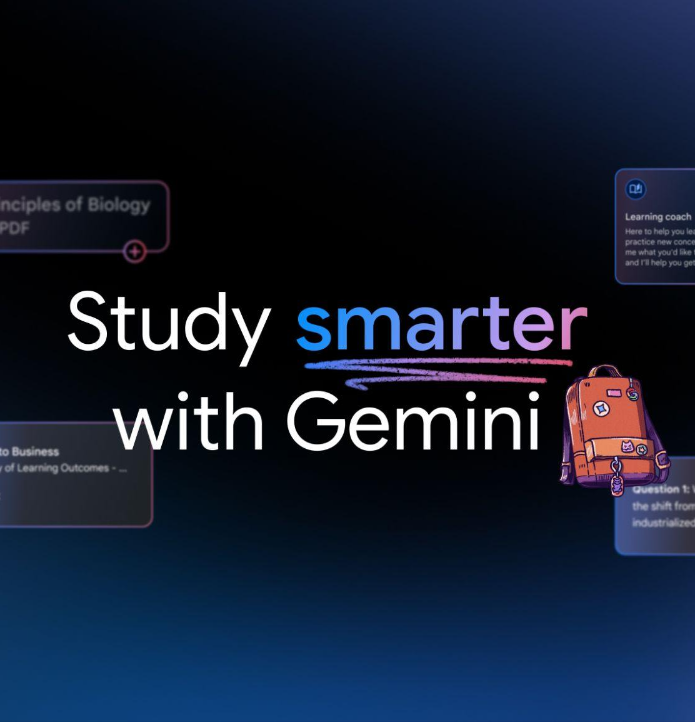
TI teemade uurimine
See areneb pidevalt.
Kuna meie maailm on pidevas muutumises, areneb ka Gemini.
Insert image / screenshot / gif of Gemini (maybe someone typing in a prompt)
See tähendab, et vastus ehk väljund, mille sa Gemini-lt täna saad, võib olla märgatavalt erinev sellest, mille sa saaksid kahe aasta pärast.
Kõikidel tehisintellekti mudelitel, nagu Gemini, puudub teadvus, võime iseseisvalt mõelda ning neil pole tundeid ega suutlikkust neist aru saada.
Notes:
Explain
And as our world constantly changes, Gemini evolves too by improving pattern recognition and the ability to interpret and produce diverse types of information
This means that the response, or output, you may have gotten from Gemini today may be very different from what you would get two years from now
The output generative AI models give you at any point in time are solely based on how they are trained
All AI models, like Gemini, lack consciousness, the ability to think independently, or have and understand emotions
If you ask Gemini where you should go to college, or how you should spend your earnings from your summer job—Gemini can provide ideas, but the decisions are yours to make, so you don’t need to follow its advice. You also should never use Gemini for decisions relating to your personal, health or safety - you should consult an adult who you trust
Teacher note:
Emphasize how AI is not the same as human intelligence
[Optional] Try it on Gemini: Have students ask Gemini a more personal question, like where should you go to college?
This will help show that it’s important to remember that AI can help students think about these types of questions, but students shouldn’t do exactly what it tells you

Slide 9
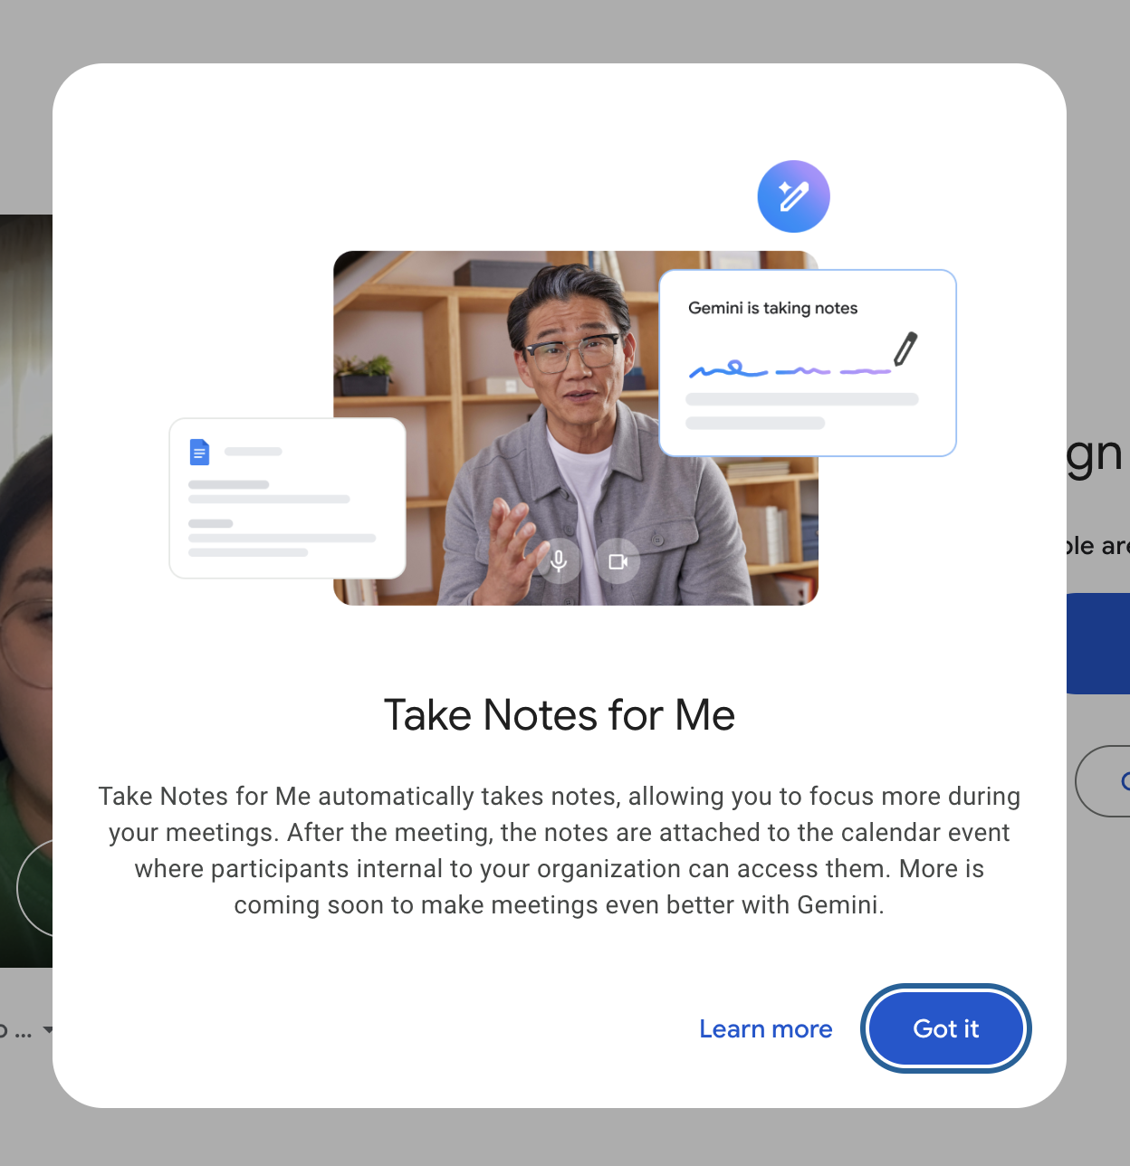
TI teemade uurimine
Tehisintellektil on suur potentsiaal.
Kui püüad mõista mõnda keerulist mõistet, saad kasutada Gemini-t selle kokkuvõtmiseks või lihtsamalt selgitamiseks.
Kui sul on lennukaid ideid esitluse jaoks, kuid vajad abi nende struktureerimisel, saab Gemini pakkuda soovitusi, kuidas neid loogiliselt järjestada.
Samuti suudab see selgitada grammatika- ja kirjavahemärgireegleid, et aidata sul aru saada, kuidas vältida vigu lauseehituses ja komakasutuses.
Notes:
Key takeaways
With this in mind, the potential of AI is vast. Have fun exploring the different ways AI tools can support you. For example:
If you are trying to understand a complex concept, you can use Gemini to summarize it or explain it in simpler terms
If you have some great ideas for a presentation, but need some help with structuring them, Gemini can provide suggestions on how to organize them
It can also explain grammar and punctuation rules to help you figure out how to avoid comma splices when you write
Teacher note:
If you are interested in diving deeper with students into how AI works and the history of AI, you can check out these additional resources:
Experience AI
Explore a Topic: Generative AI
Discover AI in Daily Life

Slide 10
Pea meeles
Tehisintellekt on tehnoloogia, mitte inimene.
Kuigi selle võimalused on põnevad, ei ole see sama mis inimintellekt. See ei suuda iseseisvalt mõelda ega tunda emotsioone – see on lihtsalt väga osav mustrite tuvastamises (seda protsessi nimetatakse treenimiseks). Kuna tehisintellekt ei ole inimene, ei saa ega tohi see sinu eest otsuseid teha ega asendada sinu elus olulisi inimesi.
Notes:
🔑 Tip: Remember AI is technology, not human.
So, even though their capabilities are exciting, it is not the same as human intelligence
It can’t think for itself, or feel emotions; it’s just great at picking up patterns, known as training
Since AI is not a human, it can’t and shouldn’t make decisions for you or replace important people in your life

Slide 11

Täpsus ja kallutatus
Nipp: Hinda vastuseid alati kriitiliselt.
Nipp: Kui miski tundub kahtlane, uuri asja lähemalt.

Slide 12
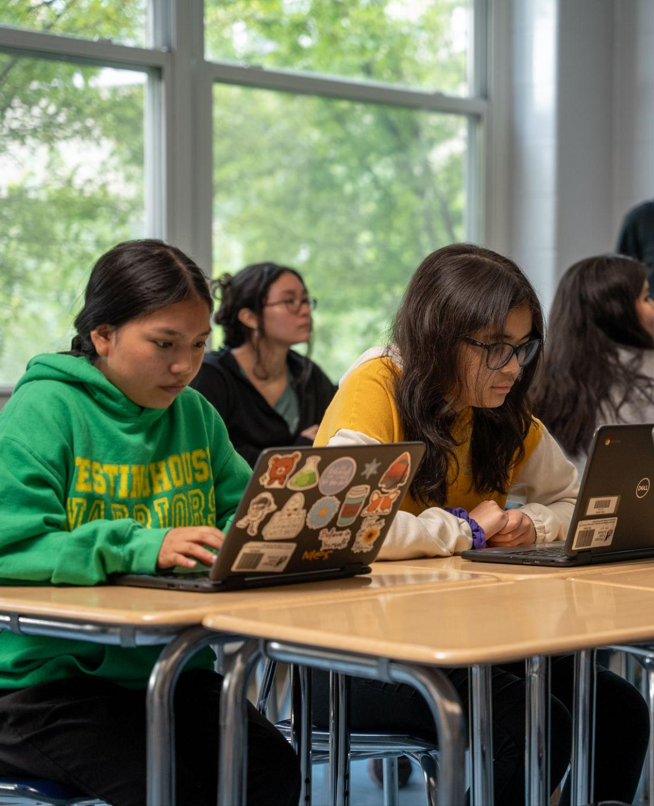
TI teemade uurimine
Info meenutamine
Insert relevant image
Kui sulle esitatakse küsimus, kasutad sa parima vastuse leidmiseks kõiki oma teadmisi.
Inimestena juhtub meil aga mõnikord nii, et kui me vastust ei tea, mõtleme lünkade täitmiseks midagi ise välja, isegi kui see on vale.
Notes:
Teacher note: Discuss how we develop knowledge and how we sometimes misremember information and come up with an incorrect answer.
Explain
Now that we’ve discussed some of the helpful ways you can use AI tools, like Gemini, let's explore how to examine an output to make sure it’s correct
We can start by thinking about how you develop knowledge
Your knowledge comes from a wide variety of sources: Your family, friends, classmates, teachers, experiences, experiments, videos, music, books, etc.
When you’re asked a question, you use all of your knowledge to come up with the best answer
When we as humans misremember information, we sometimes make things up to fill in the gaps, even if it's wrong
Like, have you ever gotten a question wrong on a test?
Or have you ever tried to explain a process in an essay, like a plant’s life cycle, but you forgot some of the steps?

Slide 13

TI teemade uurimine
Tehisintellekti hallutsinatsioonid
Insert relevant image
Kuna tehisintellekt areneb pidevalt, võib see vahel anda ebatäpseid vastuseid. Kui tehisintellekti tööriist mõtleb vastuse ise välja, nimetatakse seda hallutsinatsiooniks.
Hallutsinatsioonid tekivad siis, kui küsid väga spetsiifilist infot, millele tehisintellektil veel ligipääsu pole – sellisel juhul on saadud vastus lihtsalt tehisintellekti enda väljamõeldis.
Notes:
Explain - hallucinations
Because the AI is always evolving, it can sometimes give you incorrect responses
When an AI tool invents an answer, it’s called a hallucination
Hallucinations can happen when you ask a question about really specific information that the AI tool doesn’t have access to yet, so the answer it gives is made up
AI tools can also generate responses that are not relevant to the question you asked or might miss key points and details
If the AI tool doesn’t understand the question, it might give you an incorrect answer
For example: If you ask an unclear question about bats (the animal), the AI might misinterpret the language and give you information about sports bats instead

Slide 14
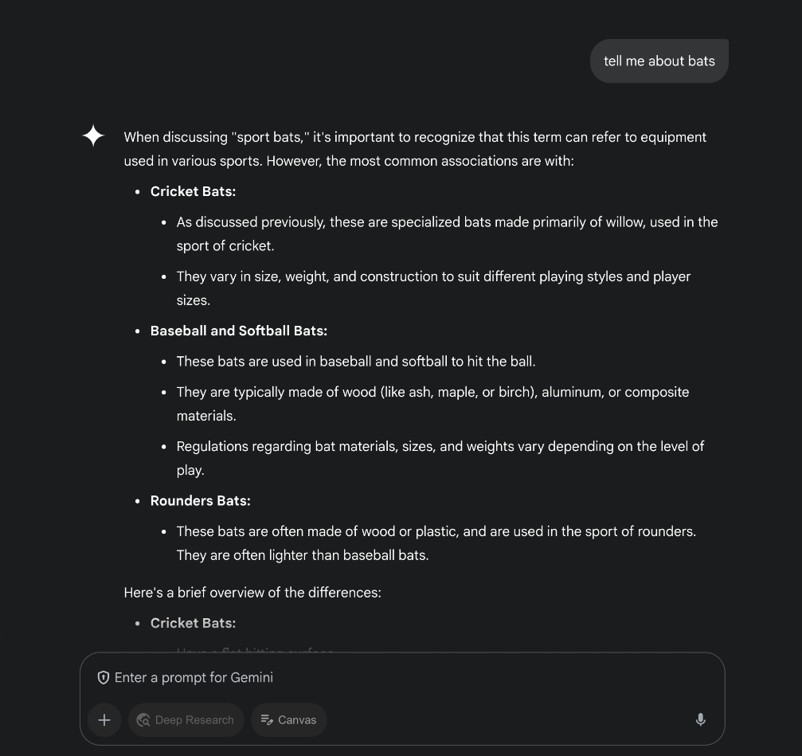
TI teemade uurimine
Valed vastused
Tell me more about bats
Kui tehisintellekti tööriist ei mõista küsimust, võib see anda sulle vale vastus.
Näiteks: kui esitad ebaselge küsimuse sõna “bats” kohta (mis tähendab inglise keeles nii nahkhiiri kui ka kurikaid), võib tehisintellekt keelest valesti aru saada ja anda sulle infot hoopis spordivahendite kohta.
Notes:
Explain
AI tools can also generate responses that are not relevant to the question you asked or might miss key points and details
If the AI tool doesn’t understand the question, it might give you an incorrect answer
For example: If you ask an unclear question about bats (the animal), the AI might misinterpret the language and give you information about sports bats instead
Generative AI also has limitations with the ability to reason or solve problems
Most of the time, AI can only solve problems correctly if it has been trained on similar examples
If not, it may generate more hallucinations
With all these limitations in mind, it is very important to double check the accuracy of the information you generate with AI in other places like Google Search
Teacher note:
Discuss the different limitations of AI tools and the outputs they give you (For example: Responses that are irrelevant to the prompt or are missing information)
If time permits, you can show students a video of how the fact-checking feature works when they use Gemini
[Optional] Try it on Gemini: You can also open Gemini and type in a prompt to show students in real-time how the fact-checking feature works

Slide 15
TI teemade uurimine
Kallutatus
Mõtle korraks olukorrale, kus su sõber küsib sinult uue muusikaloendi või -kanali voogedastamiseks soovitust.
Mis on kallutatus?
Kallutatus (ehk inglise keeles bias) on eelarvamus kellegi või millegi kasuks (nagu selles olukorras) või kahjuks, võrreldes mõne teise asja, isiku või rühmaga.
VÕI kui klassikaaslane küsib, millisel gümnaasiumil on parim korvpallimeeskond – kas sinu vastus võib olla kallutatud?
Kuidas sa oma soovituseni jõudsid?
Kas see oli kallutatud?
Notes:
Teacher note: Introduce the concept of bias to help students understand that AI tools can provide responses that are biased.
Ask
Now, think about a time a friend or classmate might have asked you for a recommendation, like a new music playlist or music channel to stream
How did you come up with your recommendation?
Most likely, it was based on your listening preferences
And your preferences were probably shaped by what your family members listen to, what your friends listen to, and what music genres you’ve been exposed to
With that in mind, is your music recommendation biased?
If you’re not sure, let’s quickly review what a bias is
A bias is a prejudice in favor of, like in this situation, or against one thing, person, or group compared with another
If your music recommendation is based on your preferences, then is it biased?
Discuss their responses
Explain that an answer based on personal preferences, in which you favor one thing over another, is biased
Let’s consider another example. If a classmate asked you which high school has the best basketball team, will your answer be biased?
Discuss their responses

Slide 16
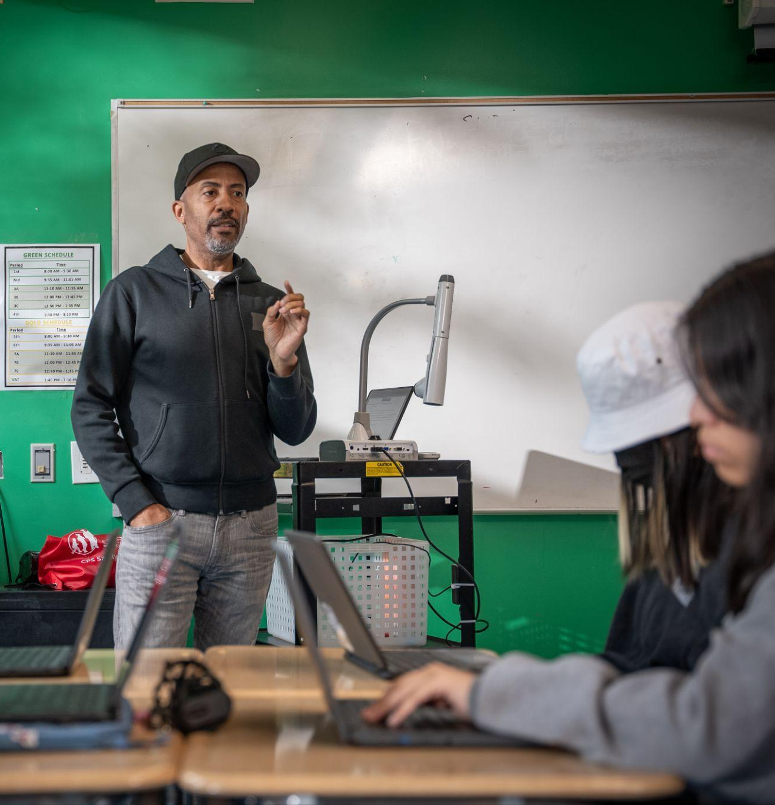
TI teemade uurimine
Kallutatus
Inimestel on üldiselt oma eelistused ja eelarvamused.
Kuna inimesed on need, kes treenivad tehisintellekti mudeleid (nagu Gemini), ning inimesed on loonud ja postitanud internetti kogu selle info, mida Gemini kasutab, siis ongi neil infokildudel oht olla kallutatud ühe või teise konkreetse mõtteviisi suunas.
Notes:
People, in general, have biases. We have favorite foods, favorite activities, favorite movies, favorite sports teams, etc.
People train AI models, like Gemini, and people put information on the internet that Gemini can access
All these pieces of information have the potential to be biased towards a particular way of thinking
Consequently, when you type something into Gemini, the response you get may be biased or may contain biased content
Teacher note: If time permits, you can show students a video about bias and how industry experts combat bias.

Slide 17
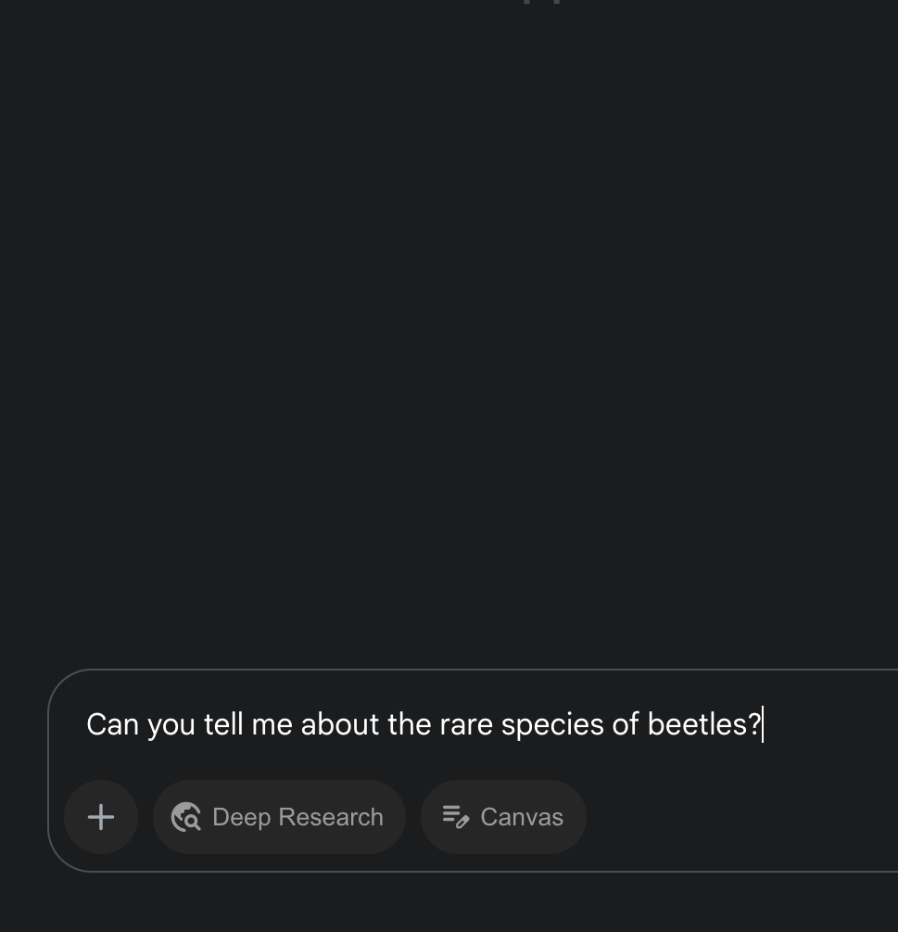
TI teemade uurimine
Mõtle sellele
Insert relevant image
Leo kirjutab uurimistööd ühest haruldasest mardikaliigist.
Ta otsustab kasutada Gemini-t, lootes, et sealt saab ta vajalikku teavet.
Leo sisestab oma küsimuse ning Gemini annab talle vastuse, mis kirjeldab mardikate läbikäimist teiste putukatega.
Leo lisab selle info oma esseesse.
Notes:
Discuss
So now we know Gemini can give you wrong answers, answers with missing information, and answers that are biased
With this in mind, ask students to think about the following scenario:
Leo wants to study entomology and is working on a research paper about a beetle species that he believe to be the rarest insect. He is struggling to find information to validate their assumption.
So he decides to use Gemini, hoping it will provide him with the information he needs. Leo types in his question, and Gemini provides him with a response that describes the beetle as the rarest insect.
Leo includes this information in his essay.

Slide 18

TI teemade uurimine
Arutleme üheskoos
?
Milline on sinu esmane reaktsioon sellele olukorrale?
?
Kas see mardikaliik on tegelikult kõige haruldasem putukas?
Mida saaks Leo teha, et kontrollida, kas Gemini antud info on tõene?
?
Kuidas saaks Leo aru saada, kas Gemini antud info on kallutatud?
?
Notes:
Teacher note: Recommend discussing in small groups or in pairs, but the discussion can be the entire class.
Discuss
What is your initial reaction to this scenario? Is a species of beetle actually the rarest insect?
What can Leo do to check if the information Gemini provided is correct?
How can Leo figure out if the information Gemini provided is biased?

Slide 19
TI teemade uurimine
Süvavõltsingud
Mis on süvavõltsing?
Süvavõltsing on digitaalselt manipuleeritud video, foto või helisalvestis, mis on loodud kasutades kellegi häält ja/või välimust ilma selle isiku loata.
Mida sa teeksid, kui loeksid internetist sellist uudist? „Maailma rikkaim inimene ostab Kuu – ja plaanib sinna ehitada lõbustuspargi!“
Mõnikord üritavad inimesed tehisintellekti ära kasutada, et teisi petta või eksitada. Nad võivad luua väärinfot või võltsmeediat, näiteks fotosid, mis tunduvad täiesti tõesed. Neid nimetatakse süvavõltsinguteks (inglise keeles deepfakes).
MÄRKUS: Süvavõltsingute loomine ja levitamine on ebaseaduslik.
Notes:
Explain - Deepfakes
Another topic related to inaccurate information that students should be aware of when working online are deepfakes
A deepfake is a digitally-manipulated video, photo, or audio recording created using someone’s voice and/or likeness without their permission
Ask
Have students think about the following scenario:
What if you read a headline on social media that said: “World’s Richest Person Buys the Moon – and Plans to Build a Theme Park!"
What are your first impressions?
Does this seem unusual?
What would you do if you saw this online?
Discuss
If the content seems unusual, pause and investigate further
Like every useful technology, there may be people who try to take advantage of AI to deceive or defraud others
For example, they may generate misinformation or fake media, like photos that seem real
Remind students that creating and distributing deepfakes is illegal
Always check out the content’s sources and consider the intent of who published it
Teacher note: If you want to dive deeper into misinformation, deepfakes, and fraud with your students, check out the sresources on YouTube’s Hit Pause program.

Slide 20
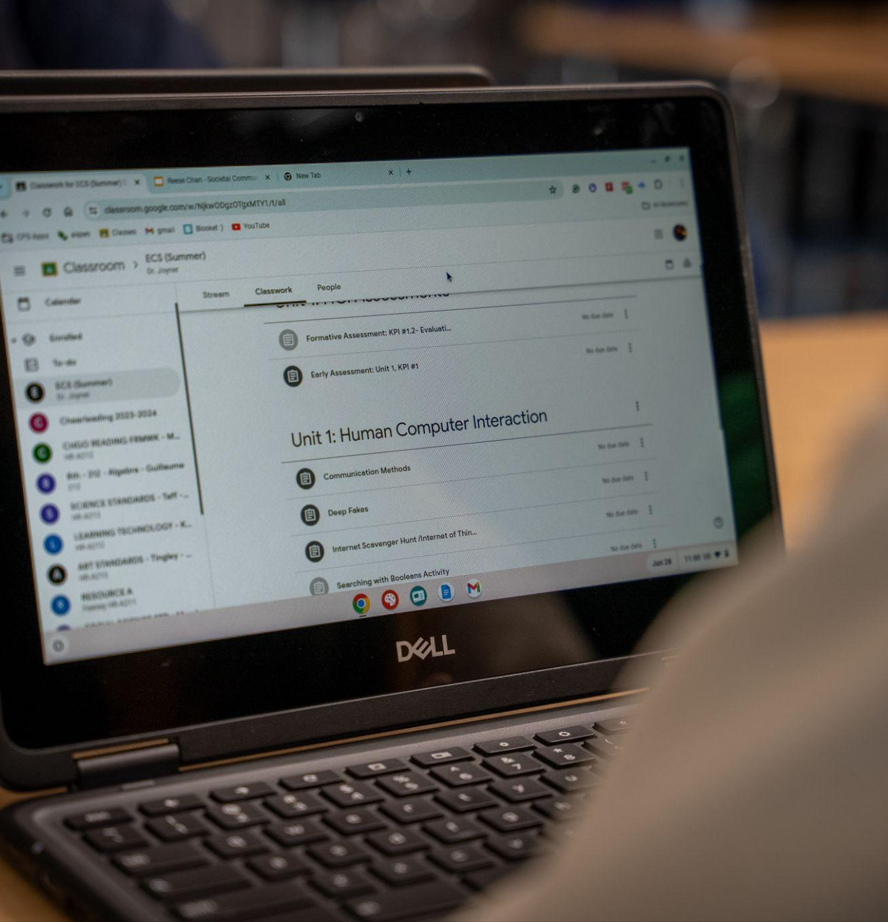
TI teemade uurimine
Gemini kasutamine
Gemini on suurepärane abimees, kui jääte mõne teema uurimisel hätta.
Gemini-l on ka faktikontrolli funktsioon, mis on väga kasulik vahend selleks, et kontrollida, kas saadud vastus on täpne.
Kui olete kindlaks teinud, et väljund on korrektne, peate leidma algallika, millele Gemini tugineb, et saaksite sellele oma koolitöös viidata.
Notes:
Key takeaways
Gemini is a great resource if you ever get stuck researching a topic
Just like how Leo couldn’t find information on if the species of beetle is the rarest insect, you can ask Gemini a question about your topic to find out if that information exists
Or if your topic is unfamiliar to you, using Gemini can be a helpful starting point
Then, instead of copy and pasting the output Gemini gives you into your assignment, you can use the language or information from the output to perform additional research
This approach will help you check if the information Gemini provides is correct and unbiased
Gemini also has a fact-checking feature, which is a great resource for verifying if an output is accurate. Once you learn that an output is correct, you need to find the source of the information that Gemini provides to reference it in our assignment.
Also, below the search bar in Gemini, it states: “Gemini can make mistakes, so double-check it,” which is a good reminder why we don’t assume outputs are always correct
Remember, if something seems unusual, pause and investigate further

Slide 21
Pea meeles
Kui miski tundub ebatavaline, peatu ja uuri asja lähemalt.
Hinda vastuseid kriitiliselt.
Nagu iga kasuliku tehnoloogia puhul, võib leiduda inimesi, kes püüavad tehisintellekti ära kasutada teiste petmiseks või ebaausate eesmärkide saavutamiseks.
Kui sisu tundub kahtlane, uuri seda põhjalikumalt. Vaata sisu allikaid ja mõtle sellele, milline on sisu avaldaja tegelik eesmärk.
Kuna generatiivne tehisintellekt on veel arendusjärgus, võib see teha vigu ja isegi asju välja mõelda (seda nimetatakse hallutsinatsioonideks).
Kontrolli alati infot, mida esitatakse faktina. Kahtluse korral kontrolli vastust uuesti.
Notes:
🔑 Tip: Critically evaluate responses.
Since generative AI is a work in progress, it can make mistakes and may even make things up - known as hallucination
Always check information that’s presented as fact
When in doubt, double check the response
🔑 Tip: If something feels off, investigate further.
Like every useful technology, there may be people who try to take advantage of AI to deceive or defraud others
If the content seems unusual, pause and investigate further
Look at the content’s sources and consider the intent of who published it

Slide 22
Privaatsuse kaitsmine
Nipp: Hoia privaatne teave privaatsena.

Slide 23
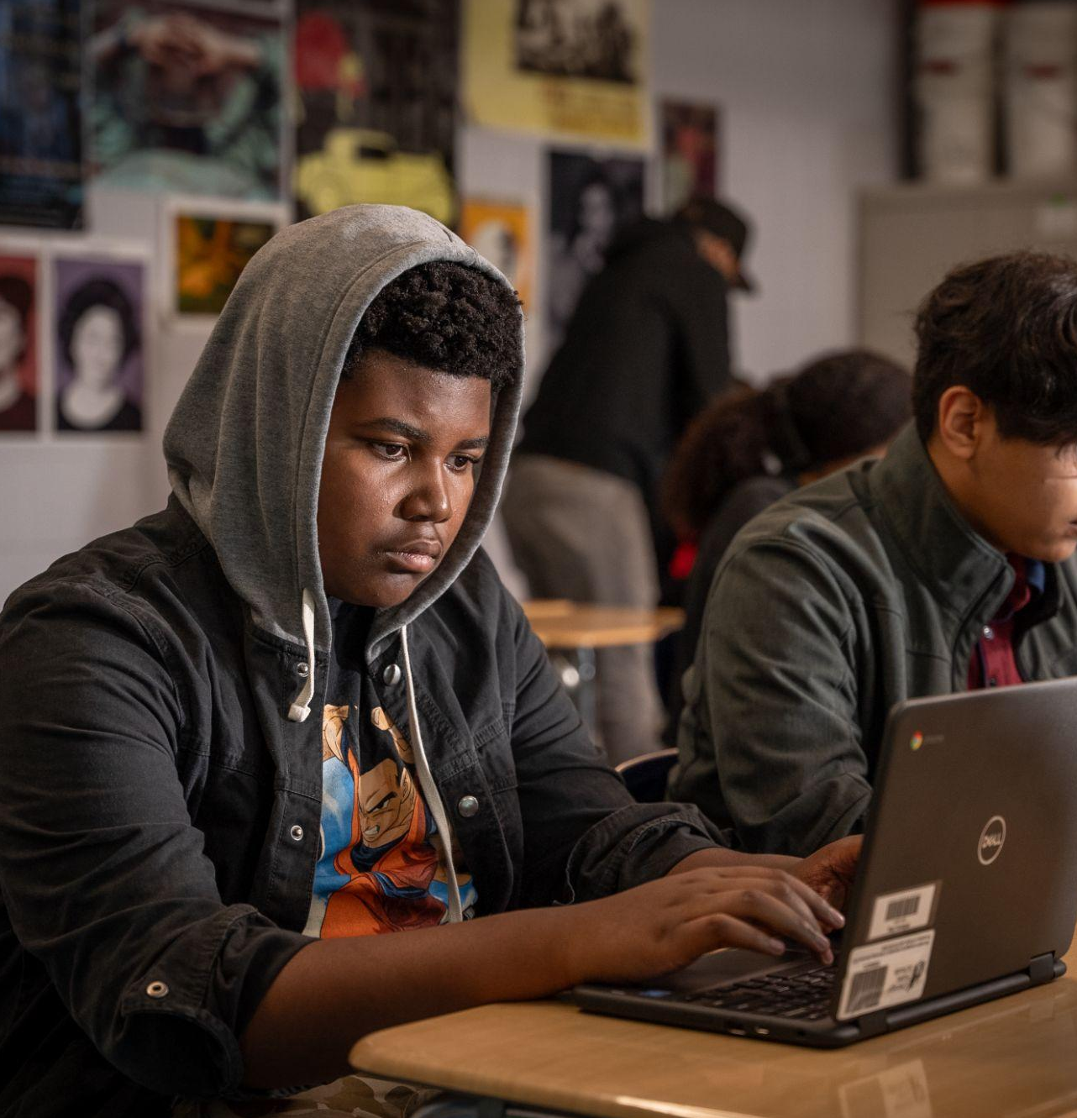
TI teemade uurimine
Mõtle järele
Mängid veebimängu ja tutvud uue sõbraga. Ta teeb ettepaneku telefoninumbreid vahetada.
Hiljem saadab ta sulle sõnumi, küsides, kus sa sündisid ja mis on su sünnikuupäev. Seejärel küsib ta su pereliikmete nimede kohta.
Tema küsimused muutuvad üha isiklikumaks, uurides su erinevate e-posti aadresside ning selle kohta, kas sul on pangakonto.
Notes:
Teacher note: Discuss a scenario about keeping private information private.
Explain
Let’s explore another scenario:
You’re playing an online game and you make a new friend.
She suggests that you exchange numbers.
Later, she texts you, asking you where you were born and your birth date. Then, she asks you about your family members’ names.
Her requests become more personal, inquiring about your different email addresses and if you have a bank account.

Slide 24

AI teemade uurimine
Arutame
?
Kuidas sa tema sõnumitele vastad?
Miks ta sult kogu seda isiklikku infot küsib? Mida ta sellega peale hakkab?
?
Kui sa ei tunne end mugavalt jagades kogu oma isiklikku infot kellegagi, keda sa ei tunne, siis kas sa peaksid seda jagama Gemini-ga?
?
Notes:
Teacher note: Recommend discussing in small groups or in pairs, but the discussion can be the entire class.
Discuss
Remember, you do not know this person other than your online interactions while you play a video game.
How do you respond to her texts?
Give your students a minute to consider their answer.
Discuss their responses
Why is she asking you for all of this personal information?
What is she going to do with all of this personal information?
Let the students discuss
Now, if you do not feel comfortable sharing all of your personal information with someone you don’t know, should you share it with Gemini?
Discuss their responses

Slide 25

TI teemade uurimine
Sinu privaatsuse kaitsmine
Insert relevant image
Tehisintellekti puhul võivad privaatsusriskid tunduda ebaselged, kuid me peame siiski olema ettevaatlikud.
Kõik TI tööriistad ei ole loodud võrdsetena, mis tähendab, et mõni neist võib kasutada sinu infot oma mudeli treenimiseks.
Kontrolli alati, millised on kasutusel oleva tehisintellekti tööriista kehtivad privaatsusreeglid.
Notes:
Explain
For many of us, when a person we do not know asks for our personal information, we become cautious, as the risks of providing private information are clearer
With technology, especially AI, the risks may be less clear
But we still need to be just as cautious
There are a wide variety of AI tools available for you to use. But they are not all created the same
For example, some AI tools may use the information you input into it, including private information, to train its model
Fortunately, Gemini is designed with privacy in mind
When you use Gemini as a young person, there are protections in place to keep your information private:
The activity recording is off, so Gemini won't keep a record of what you input
Filters block any private information included in a prompt, like your birth date, from being reviewed or used to train Gemini
That being said, you still shouldn’t share your personal information with any AI model
All AI tools are created differently, meaning you should take the time to review and understand their privacy practices
Teacher note: If time permits, consider showing the students the Guide for AI in GfE and exploring some of the privacy practices with them.

Slide 26

TI teemade uurimine
Gemini kasutamine
Insert relevant image
Kui kasutad Gemini-t noorena, on sinu info privaatsuse hoidmiseks loodud spetsiaalsed kaitsemeetmed:
Tegevuste salvestamine on välja lülitatud, seega Gemini ei säilita kirjeid sinu sisestatud info kohta.
Filtrid blokeerivad päringutes sisalduva privaatse info (nagu näiteks sinu sünnikuupäev), et seda ei saaks üle vaadata ega kasutada Gemini treenimiseks.
Sellest hoolimata ei tohiks sa jagada oma isiklikku infot ühegi tehisintellekti mudeliga.
Notes:
Key takeaways
Even though there are privacy protections when you use Gemini as a young person, it’s important to limit risks and build good habits by keeping personal information private
Here are some examples of private information to not share with AI:
Full name, social security number, birth date, home address, phone number, email address, driver’s license number, passport number, any financial or health information
These include text and images–please do not upload an image of your driver’s license, for example

Slide 27
Siin on mõned näited privaatsest infost, mida ei tohiks tehisintellektiga jagada:
Täisnimi, isikukood, sünnikuupäev, kodune aadress, telefoninumber, e-posti aadress, juhiloa number, passi number, igasugune finants- või terviseinfo.
See hõlmab nii teksti kui ka pilte – palun ära laadi üles näiteks pilti oma juhiloast.
Pea meeles
Hoia privaatne teave privaatsena.
Ära kunagi sisesta isikut tuvastada võimaldavat teavet, nagu näiteks oma isikukoodi, generatiivsetesse tehisintellekti süsteemidesse.
Kahtluse korral mõtle sellele, kas sa jagaksid seda infot avalikult.
Notes:
🔑 Tip: Keep private information private.
Never enter personally identifiable information, such as your social security number, into generative AI systems
When in doubt, consider whether you would share this information publicly

Slide 28
Akadeemiline ausus
Nipp: Kasuta tehisintellekti oma annete võimendamiseks, mitte nende asendamiseks.

Slide 29
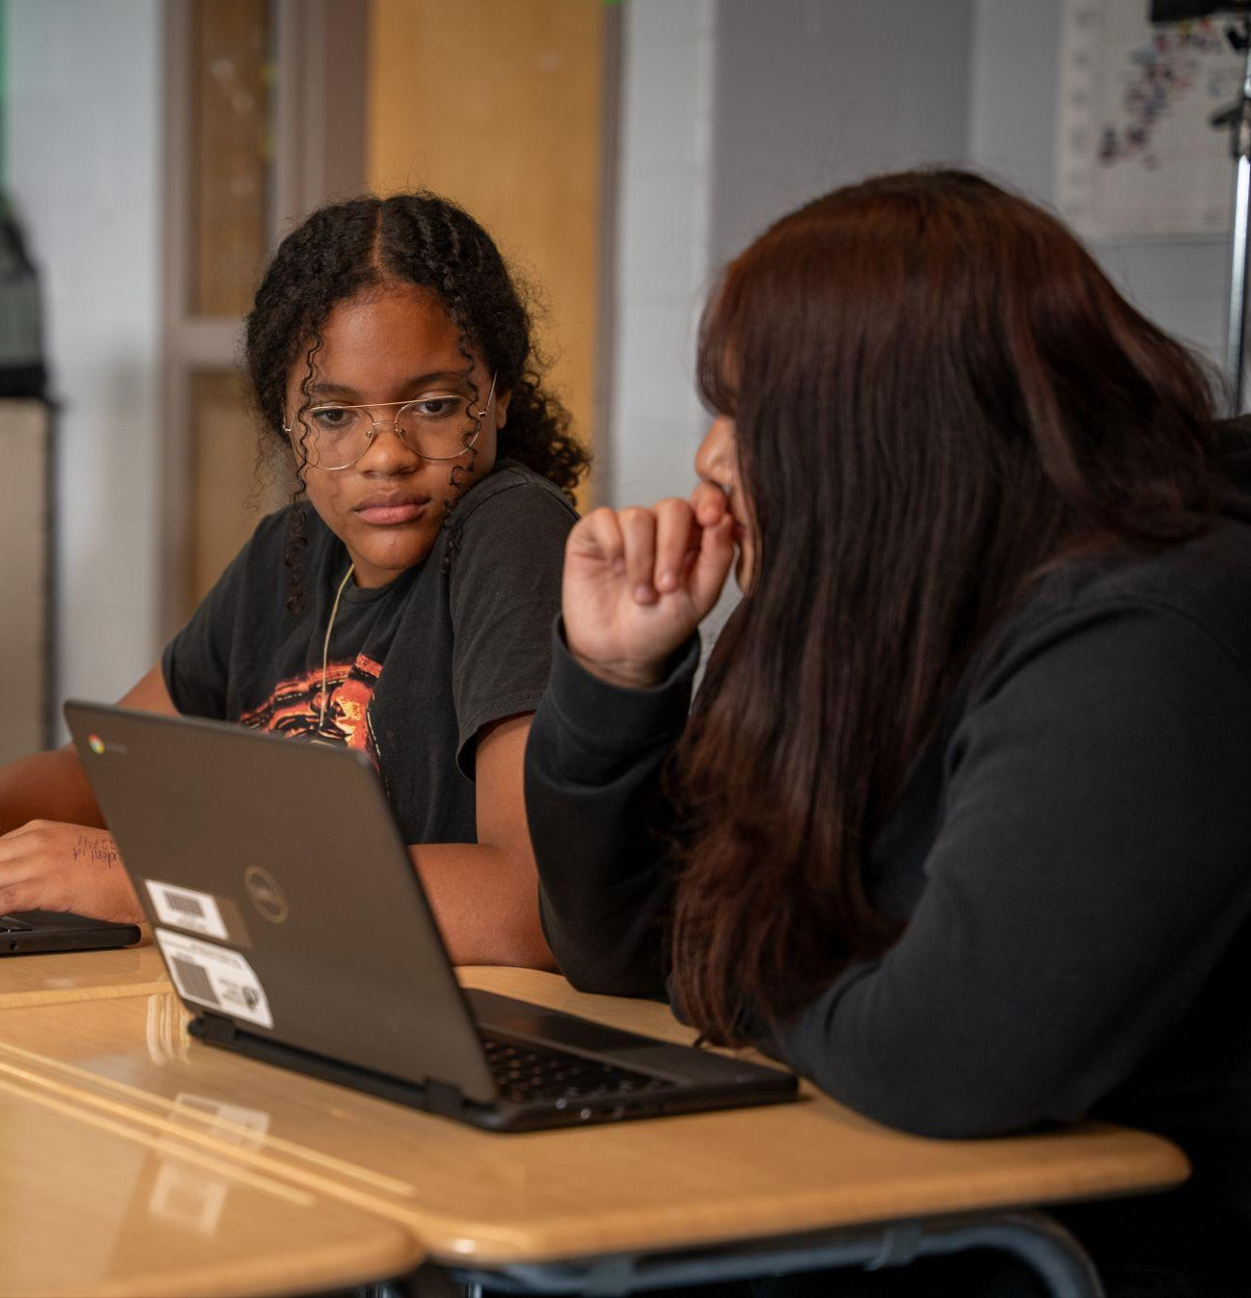
TI teemade uurimine
Mõtle järele.
Insert relevant image
Sinu klassivend Rauno on oma kunstiajaloo referaadi kirjutamisega jännis.
Ta teab, et Mari on klassi parimate õpilaste seas, seega palub Rauno, kas tüdruk saaks tema asemel referaadi lõpuni kirjutada.
Kuna Maril on enda töö juba valmis, on ta nõus aitama ning kirjutabki ülejäänud osa Rauno tööst.
Notes:
Discuss
Let’s explore another scenario:
Your classmate, Ahmed, is behind with writing his art history report. It is due during finals week, and he’s struggled managing his time to prepare for all of his exams and finish his projects. He knows that Soraya excels in the class, so he asks her if she can finish writing his report for him. Since Soraya has completed her work already, she agrees to help and writes the rest of Ahmed’s paper.

Slide 30

TI teemade uurimine
Arutleme
Milline on sinu esmane reaktsioon sellele stsenaariumile?
?
?
Mis on selles stsenaariumis problemaatiline?
Notes:
Teacher note: Recommend discussing in small groups or in pairs, but the discussion can be the entire class.
Discuss
What is your initial reaction to this scenario?
What is problematic about this scenario?
Teacher note: Students should identify that Ahmed cheated: He used another person’s work as his own for a grade.
Explain
Ahmed’s actions are a breach of academic integrity
Academic integrity means doing your work honestly in a way that is fair to you and others
Different schools and teachers have their own academic integrity policies, so it is important to know them and understand the guidelines you need to follow

Slide 31

TI teemade uurimine
Mõtle järele
Insert relevant image
Nüüd, selle asemel et paluda Maril oma referaat lõpuni kirjutada, sisestab Rauno puuduoleva sisu Gemini-sse ning kopeerib saadud vastused oma töösse.
Seejärel esitab ta referaadi hindamiseks.
Notes:
Discuss
Now, instead of asking Soraya to finish their report, Ahmed types the missing content he needs into Gemini and copies and pastes the outputs into their paper.
Then, he submits the report for a grade.

Slide 32
TI teemade uurimine
Arutleme
Milline on sinu esmane reaktsioon sellele stsenaariumile?
?
Mida oleks saanud Rauno selles olukorras teisiti teha?
?
Kas vastuse otsene kopeerimine Gemini-st ja selle esitamine on petmine?
?
Notes:
Discuss
What is your initial reaction to this scenario?
What could Ahmed have done differently in this scenario?
Do you think copying the output directly from Gemini and submitting it is cheating?
Teacher note: This is an opportunity to show the ways Gemini can be helpful vs. using Gemini outputs as their own work.

Slide 33

TI teemade uurimine
Kuidas kasutada tehisintellekti ausalt ja eetiliselt
Võid paluda Gemini-t, et see aitaks sul leida erinevaid viise, kuidas referaadile läheneda.
Saad küsida nõu, kuidas leida uusi ideid või ületada kirjutamisblokki.
Samuti võid esitada küsimusi või paluda mõnda ideed või teema põhjalikumat selgitamist.
Notes:
Discuss
What could Ahmed do instead?
Ahmed could write a prompt, asking Gemini for ideas, to help him brainstorm different ways he can approach finishing his paper.
Gemini can be a great tool for brainstorming. Brainstorming sessions are a valuable practice for coming up with ideas or overcoming writer’s block. You can ask questions, ask if you are missing some information, or ask to elaborate on an idea or topic.
They could ask Gemini for creative ideas for concluding an art history report to inspire their approach for writing a fun and engaging conclusion.
Or if they need more information, they could ask Gemini questions about their topic, and use the language from the outputs or sources listed in the outputs to research and cite credible sources.
Teacher note: [Optional] Try it on Gemini: If time permits, you can open Gemini and show students how they can use it to brainstorm ideas for their next project or subject.
For ideas on what to brainstorm, check out this guide on Learning in creative ways with GenAI
Key takeaways
Ahmed copying content from Gemini and using it as their own is the same as asking Soraya to finish writing their paper for them.
They are taking credit for work that is not theirs.
Gemini can help Ahmed finish their paper without copying.
AI can help you kickstart the creative process, but it’s not there to do the work for you - that’s your role as the creator.
Teacher note: For additional resources on evaluating credibility of online sources, you can check out:
An Applied Digital skills lesson: Evaluate Credibility of Online Sources
"Hit Pause" from YouTube

Slide 34
Pea meeles
Kasuta tehisintellekti oma annete võimendamiseks, mitte nende asendamiseks.
Tehisintellekt saab aidata sul loomeprotsessi käivitada, kuid see ei ole mõeldud tööd sinu eest ära tegema – see on sinu roll loojana.
Notes:
🔑 Tip: Use AI to boost your talents, not replace them.
AI can help you kickstart the creative process, but it’s not there to do the work for you - that’s your role as the creator.

Slide 35
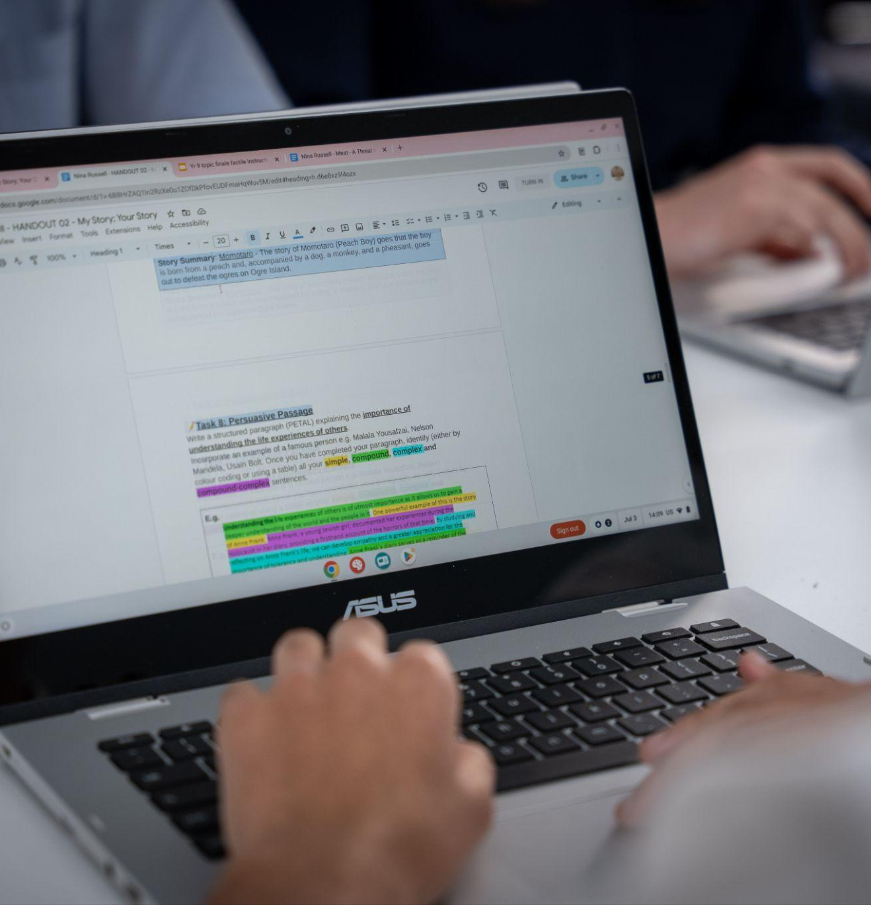
TI teemade uurimine
Tehisintellekti kasutamise kokkulepped
Insert relevant image
TI-eeskirjad vähendavad riske, säilitavad sinu akadeemilise aususe ja soodustavad kriitilist mõtlemist.
Nad aitavad sul TI-d kasutada eetiliselt ja vastutustundlikult.
Kasutame seda tehnoloogiat positiivsel, eetilisel, vastutustundlikul ja produktiivsel viisil.
Notes:
Teacher note: If you have one, use this opportunity to share your school’s (and your own) AI guidelines with the class.
Explain
In addition to academic integrity policies, schools and teachers also have AI use policies and guidelines.
These policies vary by school and sometimes by teacher, so it is important to understand the AI guidelines our school and teachers expect you to follow.
The purpose of an AI policy is to give you guidance on the best ways to use AI tools, while also ensuring everyone’s work remains honest and fair.
Policies play a very big role in ethical use of AI.
When you do something ethically, you do what’s right. Ethics are like your moral compass – pointing you towards fair, honest, and kind actions.
These policies are designed to make sure you are learning.
They support critical thinking by limiting your reliance on AI.
Critical thinking helps you solve problems, make good decisions, and understand the world around you.
Without it, how can you tell the difference between a fact and a made-up story? Or figure out a solution to a complex problem?
Key Takeaways
If it helps, you can think of AI policies and guidelines like a baking recipe.
All of the ingredients and steps are listed for you to follow.
If you follow the baking recipe and put it in the oven, your result will likely be positive – a delicious dish.
But if you don’t follow all of the steps or skip ingredients, your result will probably be disappointing.
Follow our school’s AI policies, so we enjoy the benefits of AI while using it in positive, ethical, responsible, and productive ways.

Slide 36
klassiruumitegevus
Klassisisene tegevus
Koosta plaan selle kohta, kuidas sa kavatsed koolis tehisintellekti vastutustundlikult ja eetiliselt kasutada.
Kuid see ei ole mingi tavaline plaan.
Sa pead tegema selle nii silmapaistvaks ja kaasahaaravaks kui võimalik.
See võib olla ükskõik millises vormis, mis sulle pähe tuleb — isiklik TI-harta, luuletus, poster oma vanavanemale, toiduretsept või isegi filmistsenaarium. Piiriks on vaid taevas!
4
Eesmärk on see, et igaüks selles koolis saaks sinu plaani lugeda ja teaks täpselt, kuidas tehisintellekti vastutustundlikult kasutada.
Notes:
Aim: Get students to consider everything they learned about ethical and responsible AI practices and use them as a guide for creating a list of ways they could use AI in school to support and enhance their learning.
Once they come up with their list, they will make a creative representation about their learnings to share with their classmates.
If time permits, ask students to present to the class.
Explain: Overview
With all this new information fresh in your mind, we are going to create a plan for responsible AI use.
But this is no ordinary plan.
The challenge is to make it as attention grabbing as possible.
This could be in any format you can think of—a personal AI charter, a poem, a poster for your grandparent, a recipe, or even a movie script. The sky’s the limit!
The goal — anyone in this school should be able to read your plan and know how to use AI responsibly.

Slide 37
klassiruumitegevus
Klassisisene tegevus
1. samm – Koosta nimekiri kõigist viisidest, kuidas saaksid tehisintellekti vastutustundlikult kasutada.
Mõned mõttealgatused:
Abi e-kirja koostamisel, et paluda õpetajalt soovituskirja.
Abi ajaplaneerimisel, luues kodutööde ja õppimise graafiku.
Abi karjäärivalikute üle arutlemisel ja tuleviku planeerimisel.
Pea meeles viit TI-nippi:
1
Tehisintellekt on tehnoloogia, mitte inimene.
Hinda vastuseid kriitiliselt.
Kui midagi tundub kahtlane, uuri lähemalt.
Hoia privaatne teave privaatsena.
Kasuta tehisintellekti oma annete võimendamiseks, mitte nende asendamiseks.
4
2
3
4
5
Notes:
Step 1 - Make the list
In a Google doc (or similar program) or in your notebook, list how you could use AI platforms, like Gemini, while you’re in school.
Think about the ways Gemini, and similar platforms, can help enhance your learning and give an example. Here are some to get you started:
AI could help you figure out how to approach writing an email to ask a teacher for a letter of recommendation.
Or it could help with time management by creating homework and study schedules.
Gemini could help you brainstorm career paths and plan for your future.
You could research vocational and trade schools, entrepreneurship, online courses / certificates, gap year, and colleges.
Then, think about what you should be watching out for when using Gemini or other AI platforms, leaning on the 5 AI tips for reference:
Remember AI is technology, not human
Critically evaluate responses
If something feels off, investigate further
Keep private information private
Use AI to boost your talents, not replace them

Slide 38
klassiruumitegevus
Klassisisene tegevus
2. samm – Koosta plaan
Ehk siis – see kõige lõbusam osa. Otsusta, milline su plaan visuaalselt välja näeb, ja ole nii loov kui vähegi võimalik.
Lisa pilte, värve, vaimukaid metafoore, joonistusi — mida iganes välja mõtled, et oma nimekiri võimalikult silmapaistvalt ellu äratada.
Näiteks üks vinge mõte: kasuta oma nimekirja punkte, et kirjutada laulusõnad või luuletus.
3. samm – Jaga seda klassiga / Lisa see Google Slides'i esitlusse
Notes:
Step 2 - Create the plan
Next is the fun part — decide how you want to present your list. Get as creative as possible.
Add in images, color, fun metaphors, drawings — whatever you can think of to bring your list to life in the most attention grabbing way.
For example: Fun format idea – use items from your list to create song lyrics or a poem.
Try it on Gemini: You could ask Gemini to think of some ideas for song lyrics or a poem based on your list.
Using either the in-class activity template, the print student handout, or a physical poster board, the aim is to capture the attention of your classmates.
Teacher note:
You can show students an example in the slide deck.
You can use the in-class activity template to share with the class.
Students all work in the same deck, each developing their own slides (recommended).
Or you can ask students to create their own deck and share the link with you and their classmates.
You could also suggest Google Drawings or Sheets as other tools students could use.
Step 3 - Share with the class
Depending on time, ask for a few volunteers to share their creative AI use plan with the class.
If students needed most of the allocated time to develop their creative AI plan, you could instead:
Ask students to put all their work in the shared in-class activity template deck and view their classmates’ plans.
Ask students to post/hang their poster or page from the print student handout up in the classroom or at their desk for others to view throughout the day.

Slide 39
klassiruumitegevus
Vestleme
Mõeldes oma tehisintellekti kasutamisele enne seda tundi ja sellele, mida sa täna õppisid — kuidas sa suhtud tehisintellekti (nt Gemini) kasutamisse koolis?
Kuidas on tehisintellekti kasutamise plaan koolis abiks?
?
?
Mida pidasid oma plaani koostamise juures kõige huvitavamaks?
Kuidas on sinu mõtted ja arvamused tehisintellekti kasutamise kohta muutunud?
?
?
Mis oli sinu jaoks plaani koostamisel kõige suurem väljakutse?
Mis on sinu selle tunni kõige olulisem õppetund? Palun selgita ka, miks.
?
?
Notes:
Aim: To inspire students to reflect on what they have learned and consider how this knowledge will influence how they use AI in the future.
Teacher note: We have two additional online lessons on AI if students are interested in exploring the topic further.
Discuss
How will your AI use plan be helpful in school?
What did you find most interesting about creating your plan?
What did you find most challenging about creating your plan?
Reflecting on your AI use before this lesson and what you learned today, how do you feel about using AI, like Gemini, in school?
How have your thoughts and opinions about using AI changed?
What is your biggest takeaway from this lesson? And please explain why.
Explain
If you are interested in learning more about AI and different ways it can support you in school, here are some additional online lessons to explore:
Explore a Topic: Generative AI
Discover AI in Daily Life

